Slide 1


Slide 2
Daily Basis Application: NeedFi Motivation
Largest and fastest growing economic sector in our country.
At this present time we don’t find any android app that contain all of our feature in one app.
Real life experience.
Solve daily problem.

Slide 3
Feature
Hospital information
Police information
Make call
Daily food price
Login panel
Sticky notes
Feedback

Slide 4
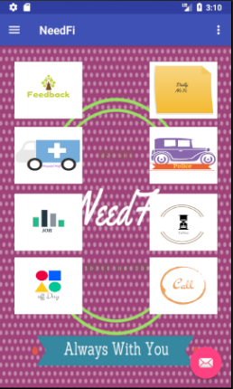
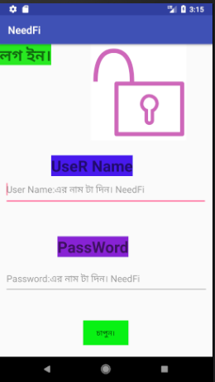
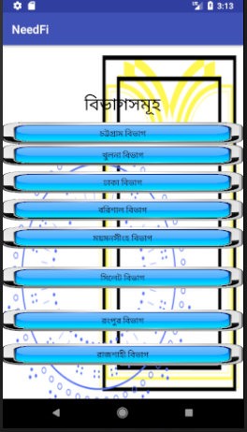
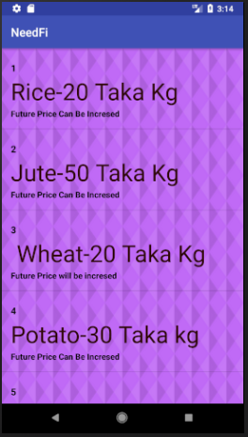
Screenshot

Slide 5
tools
Xml
Java
SQLite
PHP
Java Script

Slide 6
Future of this project
If we success to complete our project then we will try to update our app.
We will upgrade our design part.
Maintain our app.
Make it more user friendly.

Slide 7


